Slide 1
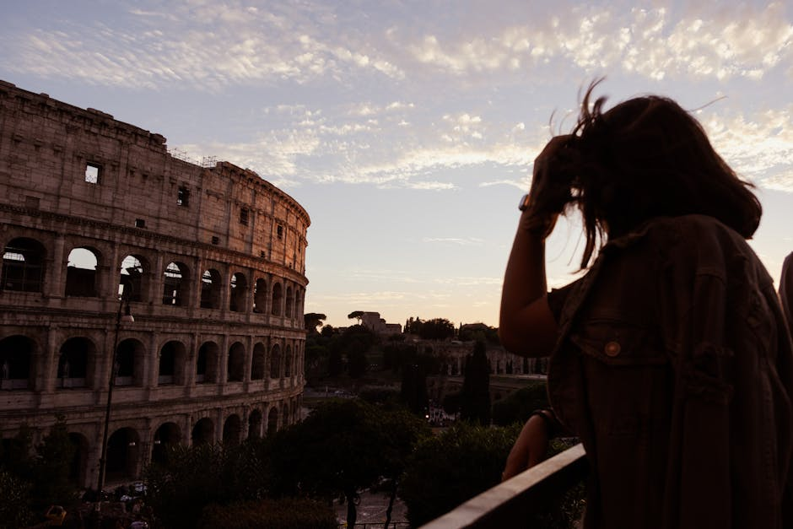
Rise and Fall: A Roman Empire Saga
From Humble Beginnings to Imperial Grandeur and Ruin

Slide 2

From Republic to Empire: The Seeds of Power
• The Roman Republic, initially a collection of independent city-states, gradually
consolidated power through military conquest and shrewd political maneuvering. Ambition,
internal strife, and the rise of powerful generals like Julius Caesar ultimately led to
the end of the Republic and the establishment of the Empire under Augustus.

Slide 3
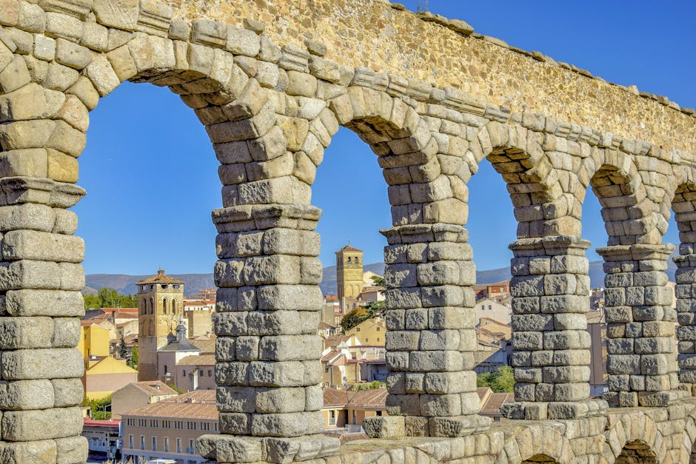
Pax Romana: An Era of Peace and Prosperity
• The Pax Romana, or "Roman Peace," a period of relative stability and prosperity lasting
for two centuries, witnessed significant advancements in infrastructure, law, and
culture. Extensive road networks, aqueducts, and public buildings testified to the
Empire's engineering prowess and organized administration.

Slide 4

The Empire's Expansion and Challenges
• The Empire's vast territorial expansion brought immense wealth and resources but also
presented significant challenges in governance and defense. Internal power struggles,
economic instability, and external threats from barbarian tribes gradually weakened the
Empire's foundations.

Slide 5
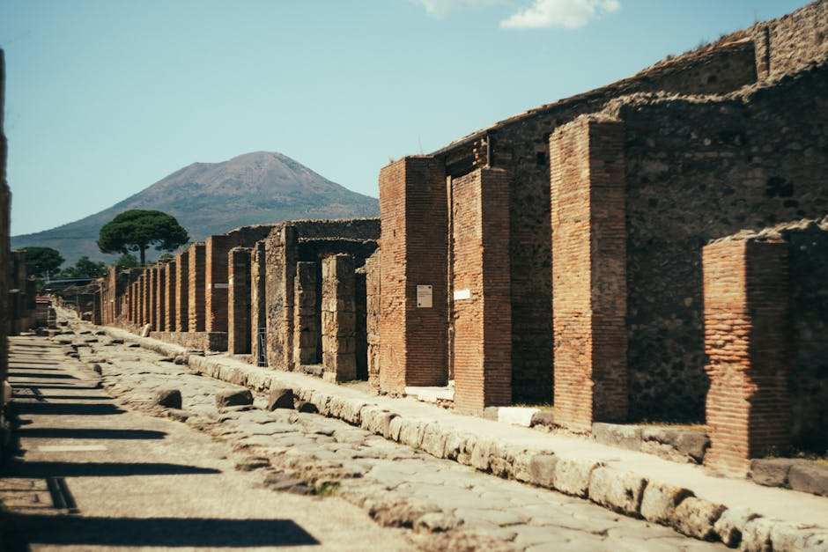
Decline and Division: The Fall of Rome
• Overextension, economic woes, political corruption, and the relentless pressure from
barbarian invasions contributed to the Empire's eventual decline and division into the
Western and Eastern Roman Empires. The Western Roman Empire ultimately fell in 476 CE,
marking a pivotal moment in European history.

Slide 6
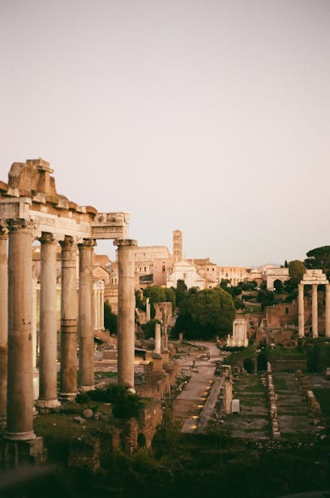
Legacy of an Empire
The Roman Empire's legacy extends far beyond its geographical boundaries and temporal
lifespan. Its contributions to law, language, architecture, and political thought
continue to shape the world we live in today. Further exploration into this fascinating
period is strongly encouraged.

